Slide 1
CSE4255 Cellular Network
Lecture 5
Handoff / Handover in cellular network

Slide 2
Handoff/ Handover
When a mobile moves into a different cell while a conversation is in progress, MSC automatically transfers the call to a new channel belonging to the new base station. This process is called Handoff or Handover.
Handoff operation involves:
Identifying a new base station,
Allocate new voice and control channels associated with the new base station.
Handoff must be performed:
Successfully
Infrequently
Imperceptible to users
Notes:
Handoffs must be completed successfully as much as possible as infrequently (as few times) as
possible and must be unnoticeable to the user (the user should not feel the H.O)

Slide 3
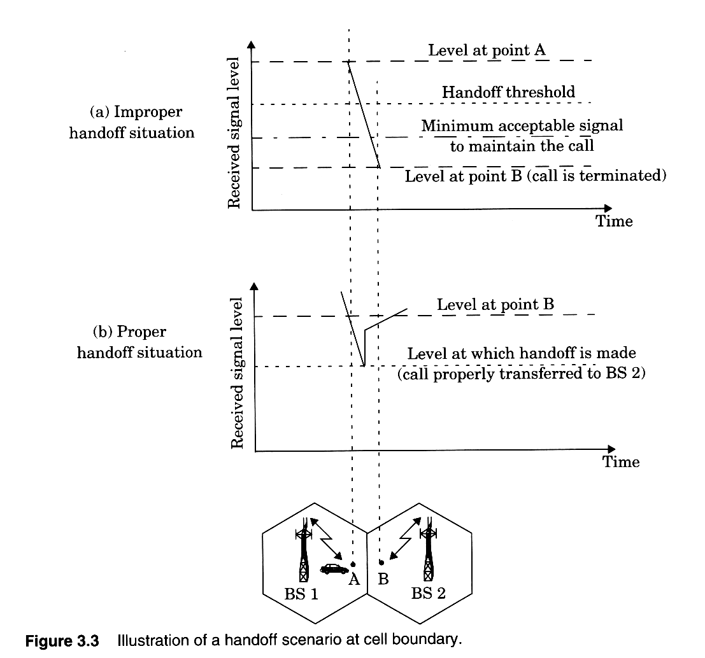
Handoff Margin:
A signal level is specified as min usable for acceptable voice quality
A slightly stronger signal level is used as threshold
Normally taken between -90dBm and -100dBm.
The margin, given by
Δ = P_{r handoff} – P_{r minimum usable}
Δ can not be too large
b/c unnecessary handoffs which burden the MSC may occur
Δ can not be too small
There may be insufficient time to complete a handoff before a call is lost due to weak signal conditions.

Slide 4
Handoff – Unsuccessful
Reasons for failed handoff:
Δ too small (i.e. P_{HANDOFF} too low)
high mobile speeds
excessive delay at MSC
High traffic level
Un-availability of channels

Slide 5
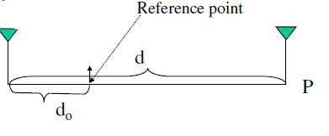

Calculate Power
Propagation measurements show:
P_{r} = Power received
P_{o} = Power at a nearby point (d_{o}) in the far field of the transmitter
d_{o} =near distance in the far field of the transmitter
d = far away distance (also in the far field of the transmitter)
n = path loss exponent, depends on environment shows how fast the signal strength decays as receiver moves away from transmitter; Usually 4 in urban area

Slide 6
Example-1
Let the speed of a mobile be v = 35 meters/sec. For n = 4, a cell radius of 500 meters (the distance at which the power is at the threshold), and a 2 second handoff, what Δ is needed?
Solution:
Assume the mobile is driving directly away from the BS, so distance d changes by 70 meters in two seconds. Consider the received power at the two times:
Pr(minimum useable) =P₀ − 10n log d
Pr(handoff) =P₀ − 10n log (d − 70)
Taking the difference of the two equations (the 2nd minus the 1st),
Δ = 10n log d − 10n log (d − 70) = 10n log (d/d − 70)
Plugging in that the call is dropped at d = 500 meters, we have
Δ = 40 log500/430 = 2.6 dB.

Slide 7
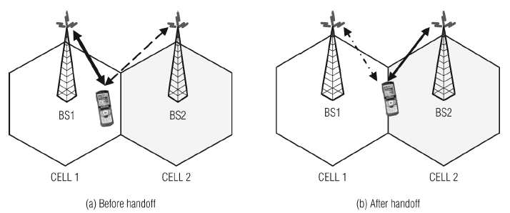
Types of Handoffs
Hard Handoff:
A hard handoff is also known as break-before-make handoff.
The link between the existing BS and the MS is broken.
A new link is established between the new BS and the MS.

Slide 8
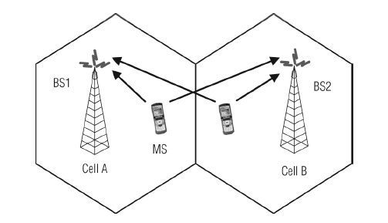
Types of Handoffs
Soft Handoff:
The soft handoff is also known as make-before-break handoff.
During this handoff process, the MS remains in communication with the original cell as well as with the new cell.
The handoff is completed when the mobile selects the best BS as the target.

Slide 9
Handoff Initiation
Handoff initiation means when a handoff should be initialized.
It is the process of deciding when to request a handoff.
Handoff decision is based on RSS from current BS and neighboring BSs.
The following are different methods for handoff initiation:
Relative signal strength
Relative signal strength with threshold
Relative signal strength with hysteresis
Relative signal strength with hysteresis and threshold

Slide 10
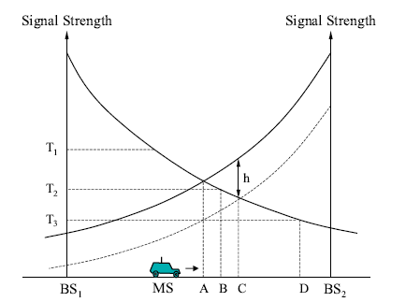
Relative Signal Strength:
This method selects the strongest received BS at all times. P_{new}> P_{old}
The decision is based on a mean measurement of the received signal.
SS fluctuates due to multi-path effects
Problem: This may result in ping-pong effect.
Notes:
Figure shows a MS moving from one BS (BS1) to another (BS2). The mean signal strength of BS1 decreases as the MS moves away from it. Similarly, the mean signal strength of BS2 increases as the MS approaches it.

Slide 11
Relative Signal Strength with Threshold (P_{new}> P_{old} and P_{old}< T):
Introduces a threshold value to overcome the ping-pong effect.
This method allows a MS to hand off only if the current signal is sufficiently weak (less than threshold) and the other is the stronger of the two
If high threshold (T₁) is used system performs like Relative SS scheme.
With a threshold of (T₂), handoff occurs at position B.
If low threshold (T₃) is used MU will move far in into the new cell -
This reduces the quality of the communication link
It may result in a dropped call.

Slide 12
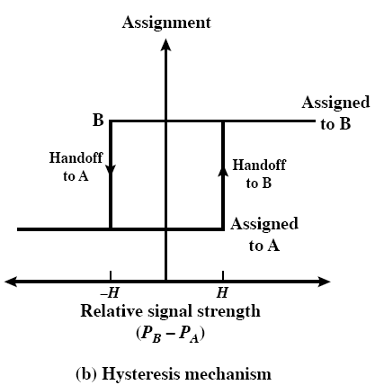
Relative Signal Strength with Hysteresis (P_{new}> P_{old} + H):
This scheme allows a user to hand off only if the new BS is sufficiently stronger by a hysteresis margin H than the current one.
Prevents the ping-pong effect, because once handoff occurs, the effect of the margin H is reversed.
Handoff mechanism has two states
While the MU is assigned to BS A, the mechanism will generate a handoff when the relative SS reaches or exceeds the H.
Once the MU is assigned to B, it remains so until the relative SS strength falls below –H, at which point is handed back to A.

Slide 13
Relative SS with hysteresis and Threshold (P_{new}> P_{old}+ H and P_{old}< T):
Handoff occurs only if
The current signal level drops below a threshold, and
The target BS is stronger than the current one by a hysteresis margin H.
In our example, handoff occurs at C, if the threshold is either T₁ or T₂ and at D if the threshold is at T₃.
Prediction Technique:
The handoff decision is based on the expected future value of the received SS.

Slide 14
Handoff Decision
Network Controlled Handoff (NCHO)
Mobile Assisted Handoff (MAHO)
Mobile Controlled Handoff (MCHO)
Notes:
Handoff decision means who will take the handoff decision. The Handoff decision is made in three ways.

Slide 15
Network Controlled Handoff (NCHO):
Used in 1st generation analog cellular system.
Signal strength measurements are made by the base stations and supervised by the MSC.
Each BS constantly monitors the signal strength of all its reverse channels to determine relative location of each mobile user.
A locator receiver (a spare receiver) in BS is used to scan and determine signal strength of mobile users in neighboring cells.
MSC decides whether handoff is required or not based on SSI values from locator receivers.

Slide 16
Mobile Assisted Handoff (MAHO):
Used in 2nd generation cellular system and faster than 1st generation.
Handoff decisions are mobile assisted
Each mobile periodically measures the received power from surrounding BSs and continually reports the results to the serving BS.
Handoff initiated when the received power from a neighboring BS exceeds the power received from the current BS (by a certain amt or for a certain period of time),
MSC no longer constantly monitors RSSI.

Slide 17
Mobile Controlled Handoff (MCHO):
Used in 3rd generation cellular system and faster than previous two generations.
Each MS is completely in control of the handoff process.
This type of handoff has a short reaction time (on the order of 0.1 second).
MS measures the signal strengths from surrounding BSs and interference levels on all channels.
A handoff can be initiated if the signal strength of the serving BS is lower than that of another BS by a certain threshold..
Notes:
Mobile unit decides whether a handoff is required or not.

Slide 18
Prioritizing Handoffs (1)
In non-prioritization schemes, new calls and handoff calls are treated the same way.
The probability that a handoff request will not be served by a new base station is equal to the blocking probability of incoming calls.
From user point of view, a dropped call is more annoying than an occasional blocked call
To improve the quality of service, assign higher priority to handoff over new call request.
Two basic methods of handoff prioritization are:
Guard channels
Queuing of hand off.
Notes:
“quality” in terms of dropped or blocked calls (not voice quality)

Slide 19
Prioritizing Handoffs (2)
Guard Channels (GC)
A fraction of the total available channels in a cell is reserved exclusively for handoff requests
Makes fewer channels available for new call requests
Problem:
Increase in call blocking probability.
Decrease in total carried traffic.
A good strategy is dynamic channel allocation (not fixed)
adjust number of guard channels as needed by demand
so channels are not wasted in cells with low traffic

Slide 20
Prioritizing Handoffs (3)
Queuing of Handoff Requests (QHR)
Queues the handoff calls when all of the channels are occupied in a target BS.
When a channel is released, it is assigned to one of the handoff calls in the queue.
A new call request is assigned a channel if the queue is empty and if there is at least one free channel in the BS.

Slide 21
QHC can be timer based:
When a channel is released at BS, a timer is started. If a handoff request is done before the timer expires, channel is assigned to it. Otherwise, channel can be assigned to new or handoff calls depending on their arrival order.
QHC can be Measurement based Prioritization Scheme (MBPS):
Handoff calls are added to the queue and assigned priority dynamically based on the power level they have. Calls with power level close to receiver threshold have the highest priority. Provided better results from FCFS basis. More control overheads.
QHC can be Most Critical First based (MCF):
Determines the first handoff call that will be cut off and assigns the first released channel to that call. Use simple radio measurements to predict the first cut off call.

Slide 22
Practical problems with Handoff
During a call
High speed vehicles need more handoff
Pedestrians may never need a handoff
With addition of micro-cells to provide capacity,
MTSO become burdened if high speed users are constantly being passed between very small cells.
Problem
Handling of high speed and low speed traffic simultaneously while minimizing the handoff intervention from MSC
Solution:
Umbrella Cell approach ensures that
The number of handoffs is minimized for high speed users and
Provides additional micro-cell channels for pedestrian users.

Slide 23
Umbrella Cell Approach
By using different antenna heights (often on the same building or tower) and different power levels,
it is possible to provide “large” and “small” cells which are co-located at a single location.
Large cell
high speed traffic
fewer handoffs
Small cell
low speed traffic
Example areas: interstate highway passing through urban center, office park, or nearby shopping mall

Slide 24
Umbrella Cell Approach (cont..)
The speed of each user is estimated by base station or MSC by evaluating
how rapidly the short term average signal strength changes over time.
If high speed user in the large umbrella cell is approaching the base station, and its velocity is rapidly decreasing,
the base station may decide to hand the user into the co-located microcell without MSC permission.

Slide 25
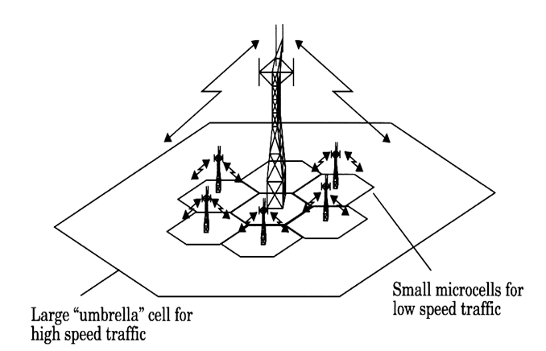
Umbrella Cell Approach
Figure 1: Umbrella Cell Approach

